Slide 1
MACHINE LEARNING (AIML ZG565)
Dr .Y VK Ravi Kumar
yvk.ravikumar@pilani.bits-pilani.ac.in

Slide 2
Session 4
(24th August,2025)

Slide 3




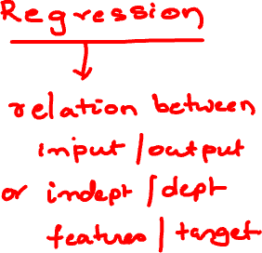
Formal Representation: Interpretation
Supervised Learning: Regression
GOAL : Previously unseen records should be assigned a value as accurately as possible.
Given (x₁, y₁), (x₂, y₂), ..., (x_{n}, y_{n})
Learn a function f (x) to predict y given x
– y is real-valued
9
8
7
6
5
4
3
2
1
0
1970 1980
September Arctic Sea Ice Extent (1,000,000 sq km)
1990
2000
2010
2020
Year Number

Slide 4
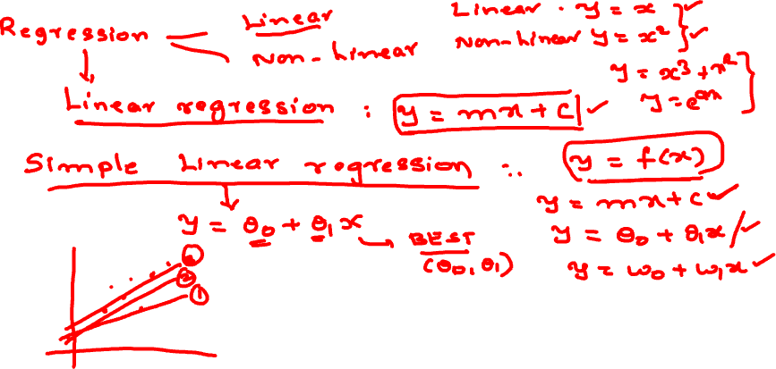

Slide 5
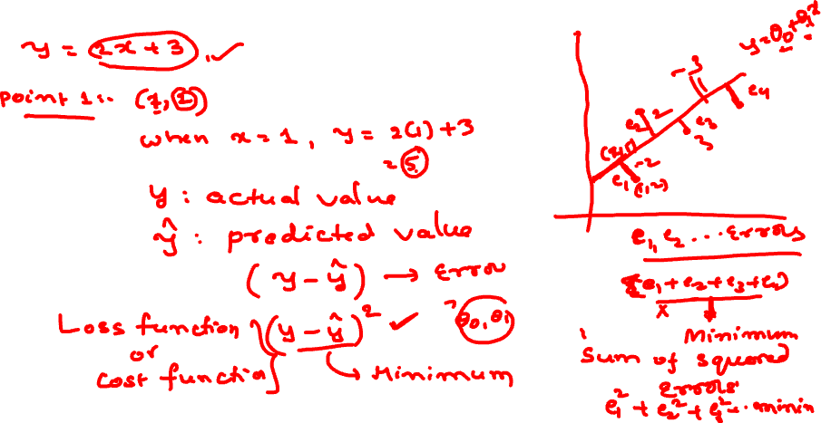

Slide 6
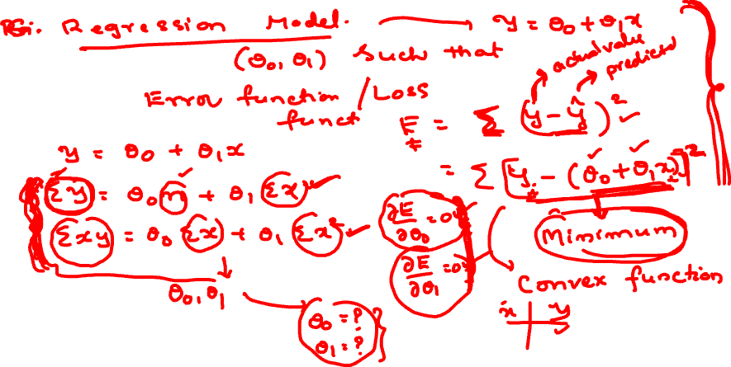

Slide 7
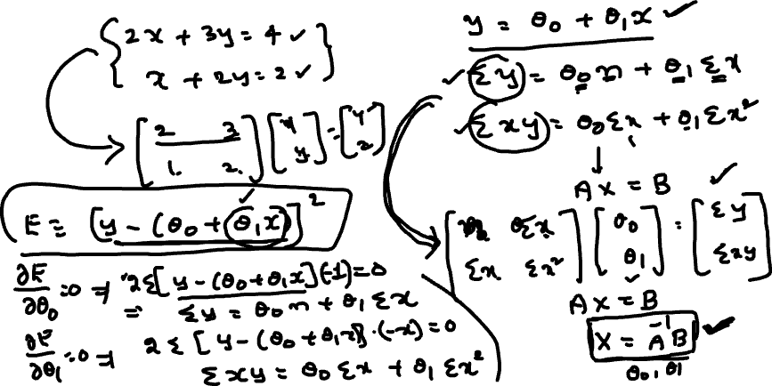

Slide 8
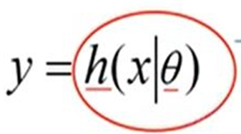

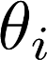
Machine Learning Process : Interpretation
Training Set
Price
(in 1000s of dollars)
Learning Algorithm
Size (feet²)
Size in feet² (x) | Price ($) in 1000's (y)
2104 | 460
1416 | 232
1534 | 315
852 | 178
… | …
Size of house
h
Estimated price
Hypothesis:
‘s : Parameters
h(.) : Model
How to choose ‘s ?

Slide 9
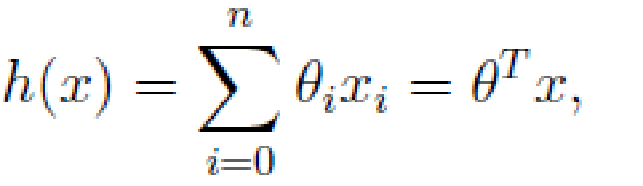
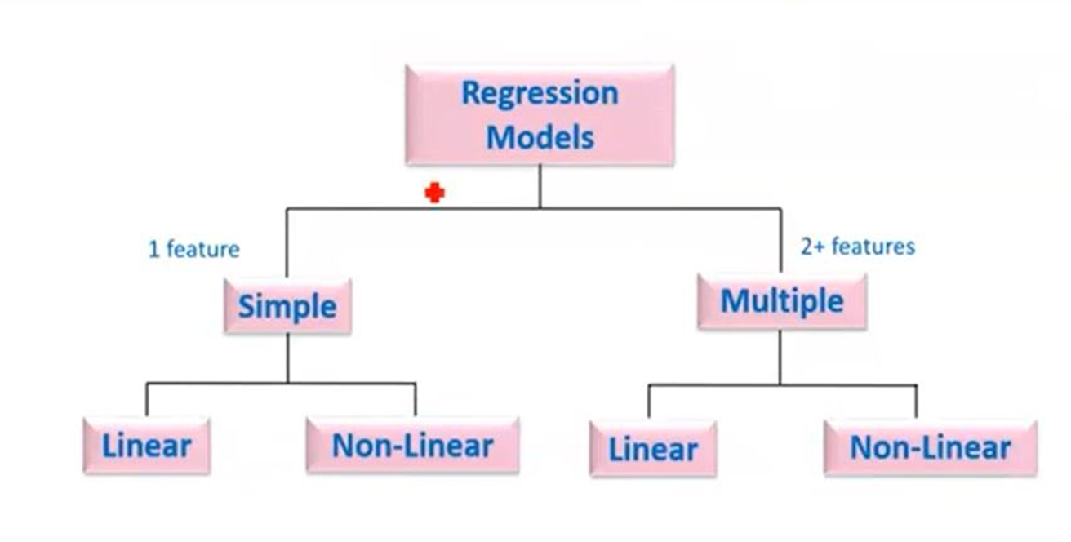
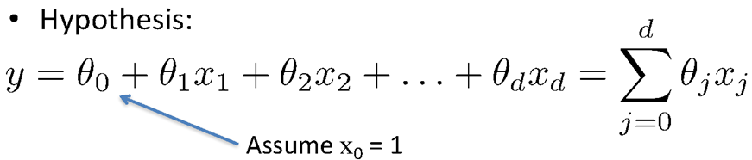
Types of Regression Models
Simple Linear regression model
(Education) x y (Income)
(Education) x₁
(Soft Skills) x₂
(Experience) x₃
(Age) x₄
Multiple Linear regression model
y (Income)

Slide 10
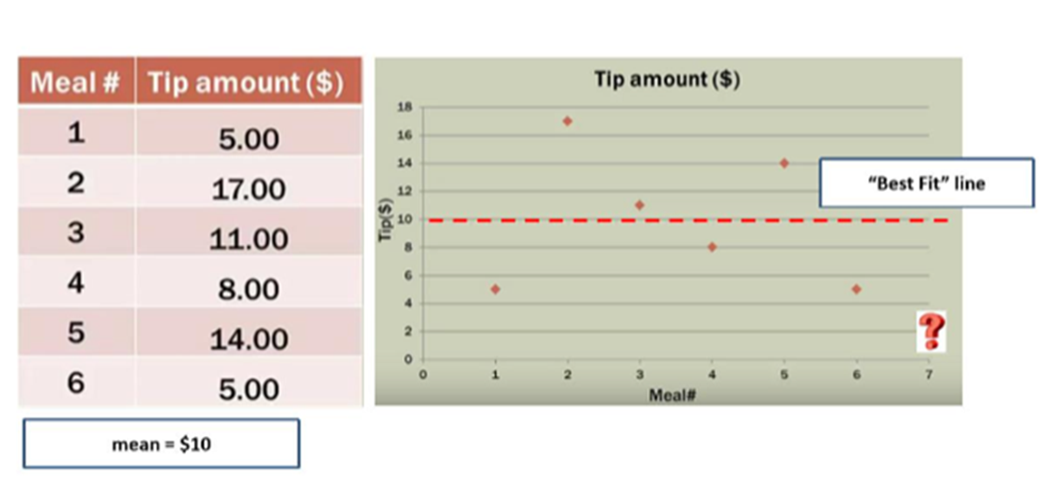
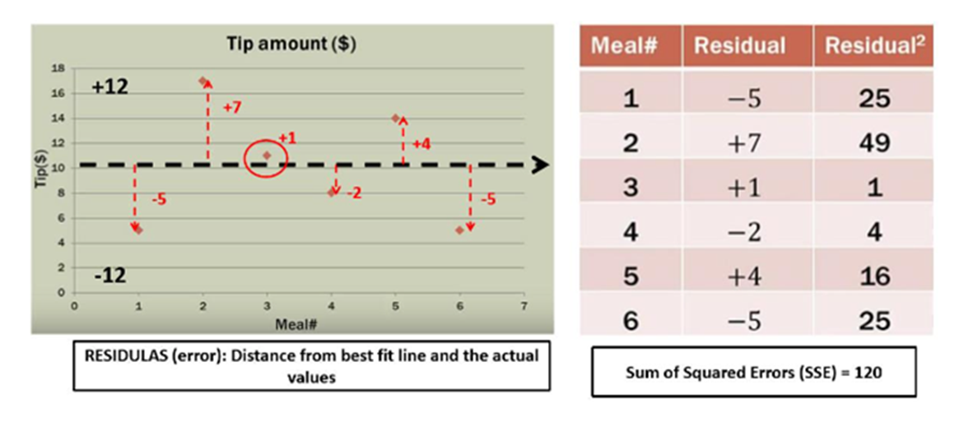
Notion of Cost Function

Slide 11
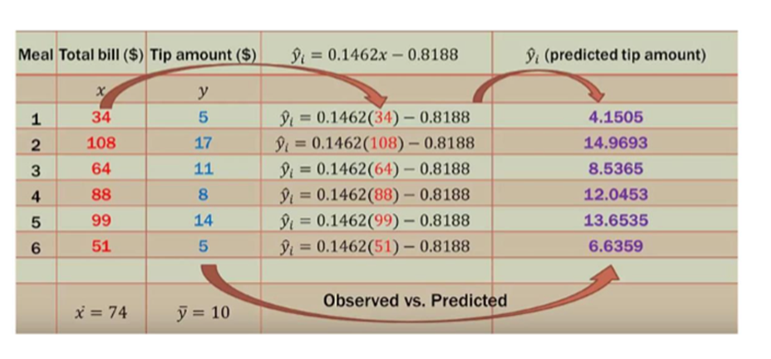
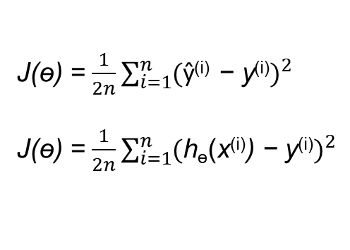
Notion of Cost Function
y = ɵ₀ + ɵ₁ x

Slide 12
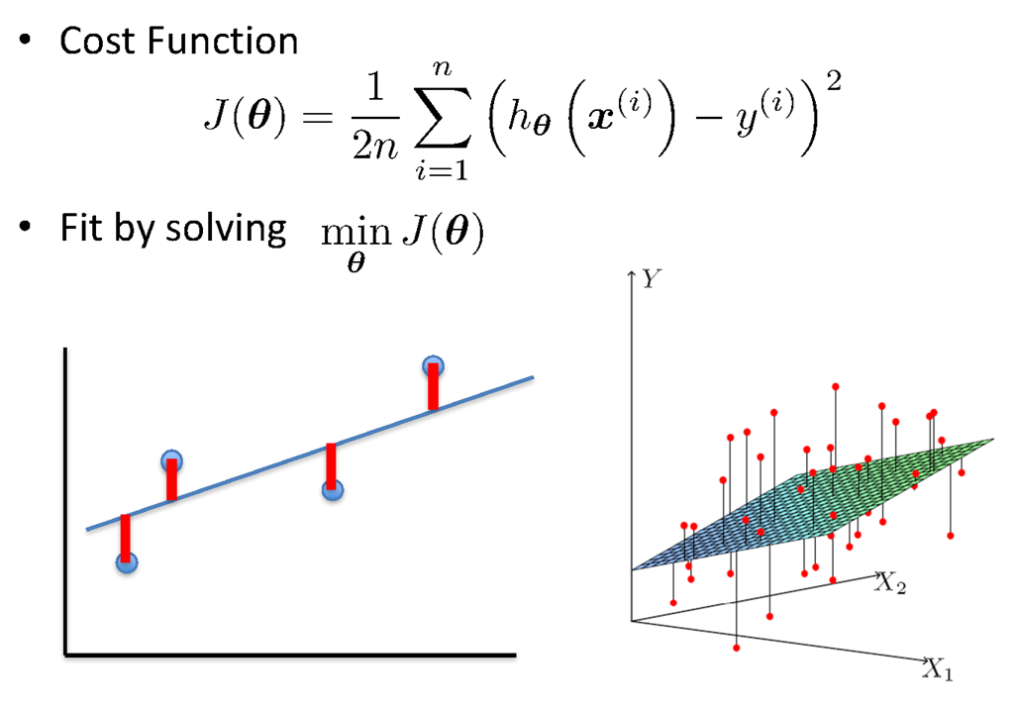
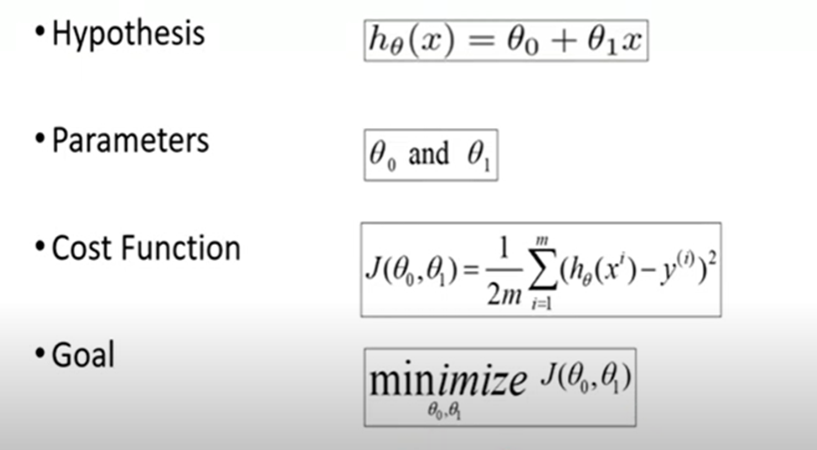
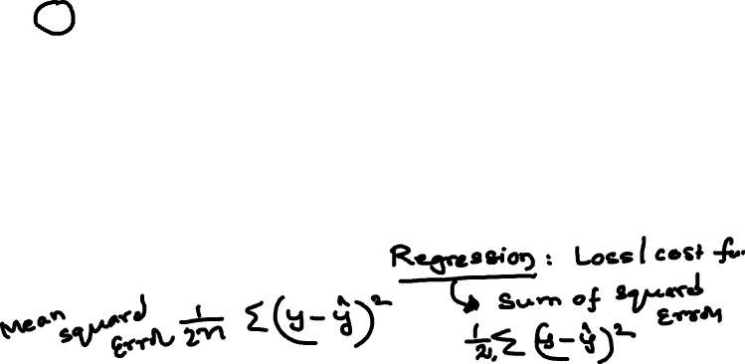
Linear Regression : Least Squares

Slide 13
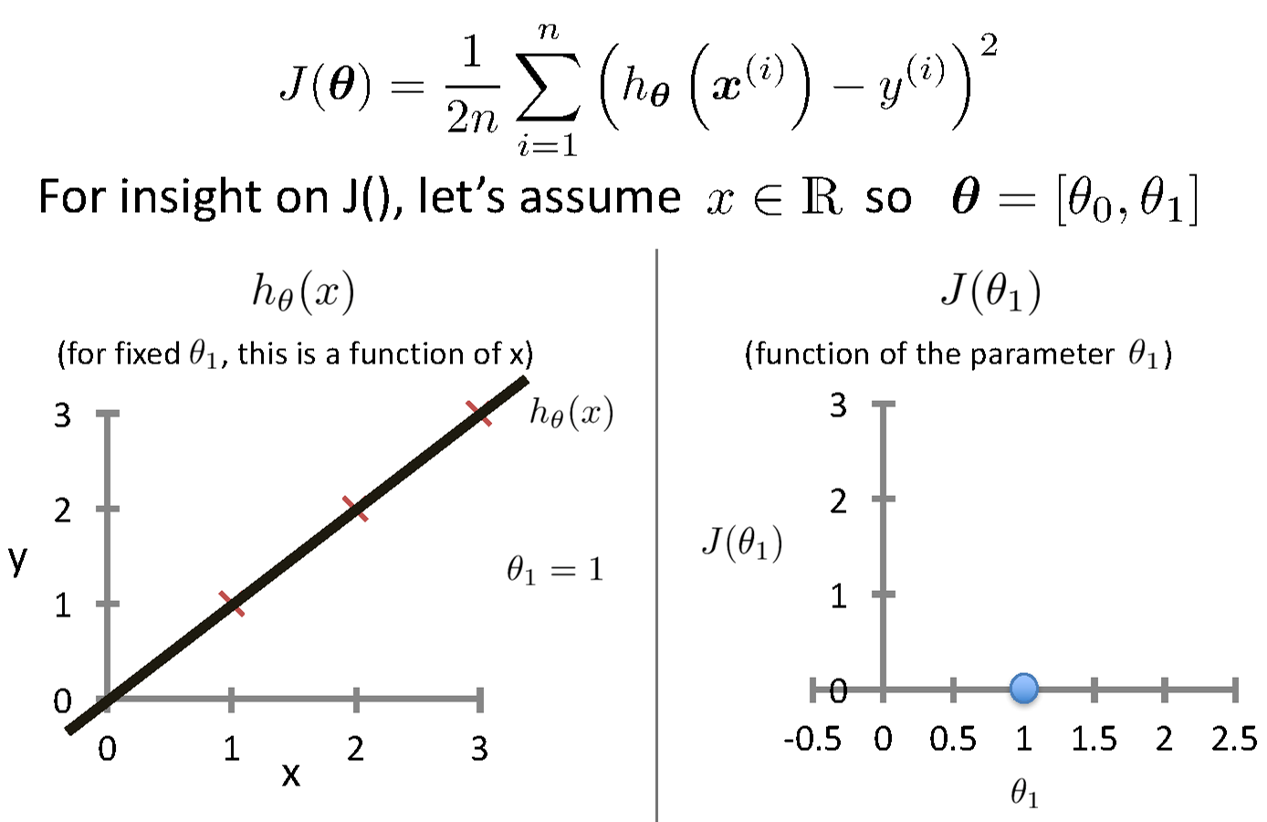
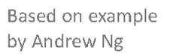
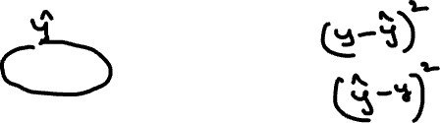
Intuition Behind Cost Function
Source Credit :

Slide 14
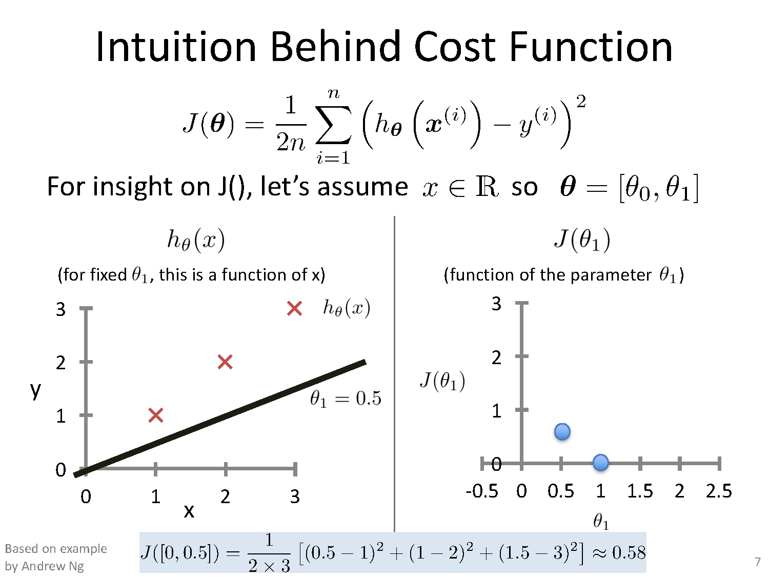
Intuition Behind Cost Function

Slide 15
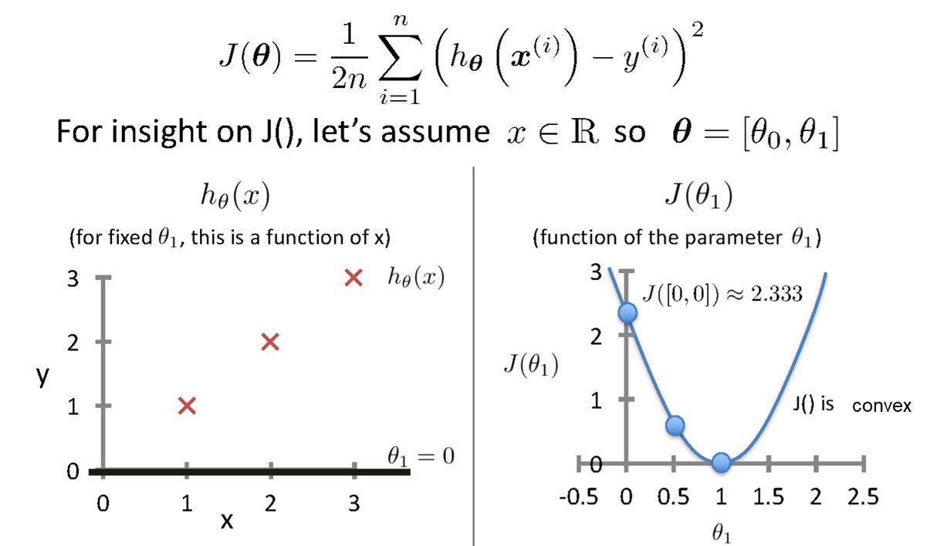
Intuition Behind Cost Function
Source Credit :

Slide 16
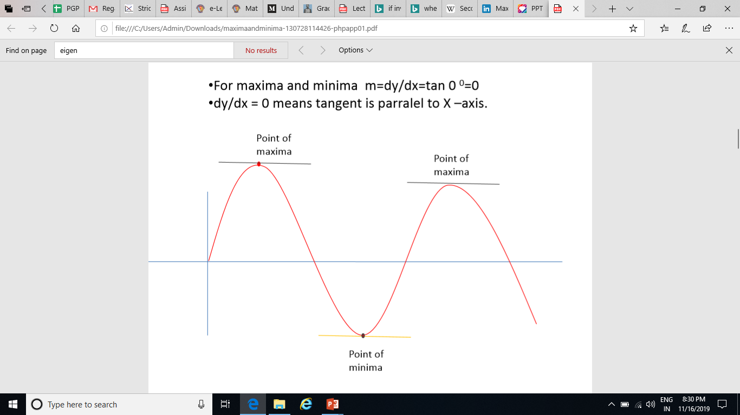
Notion of Maxima and Minima of a function - In General

Slide 17
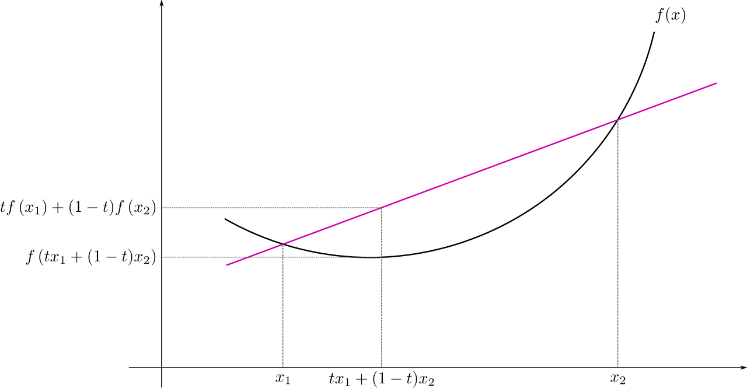
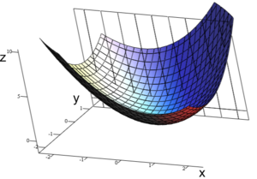
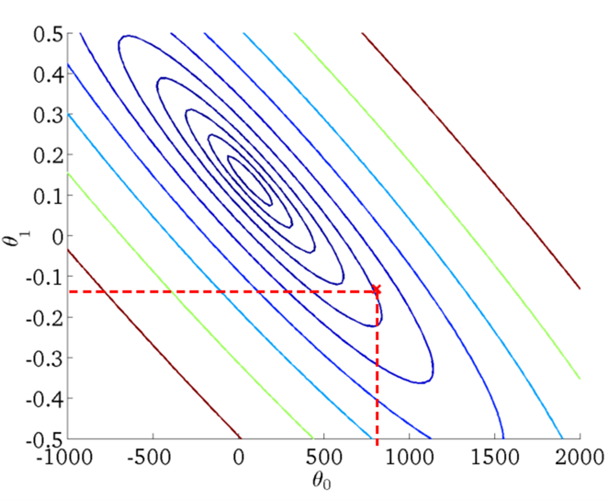
Convex function: Multivariate View
Real-valued function defined on an n-dimensional interval is called convex if the line segment between any two points on the graph of the function lies above or on the graph

Slide 18
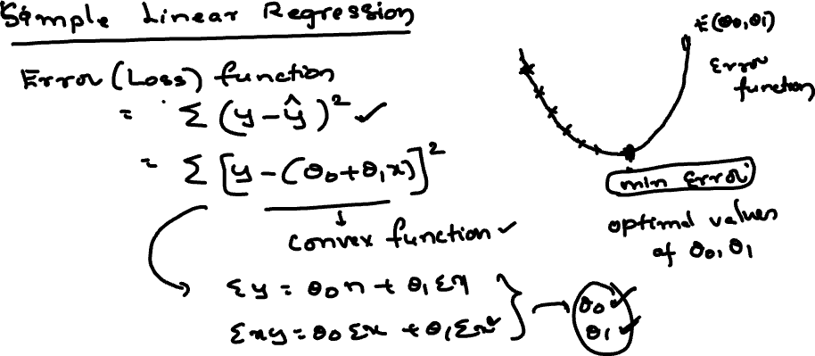

Slide 20
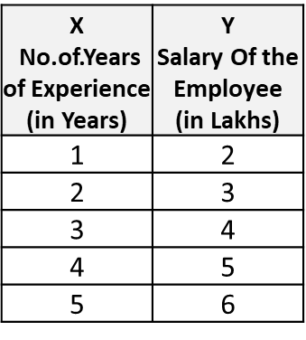
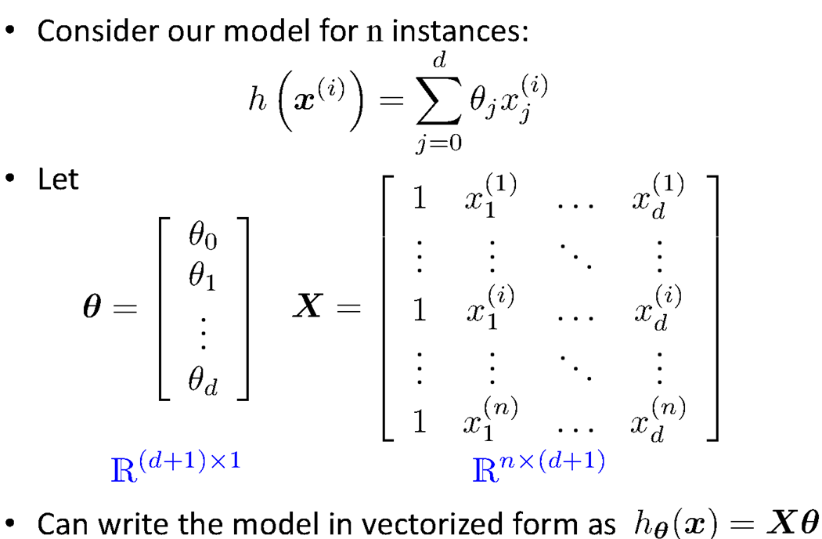
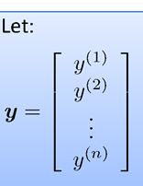
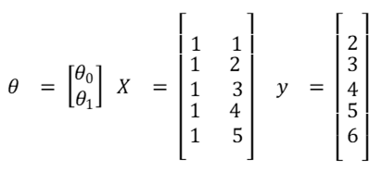
Vectorization

Slide 21
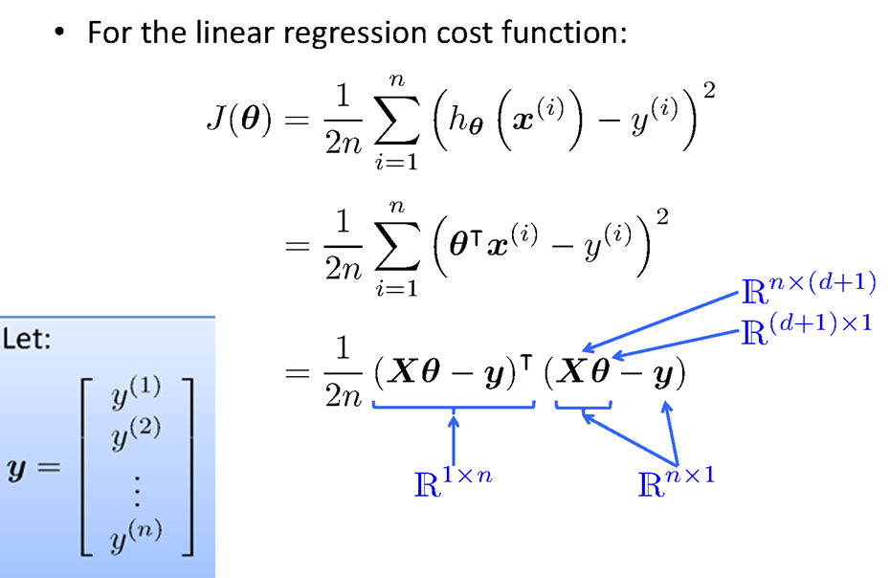
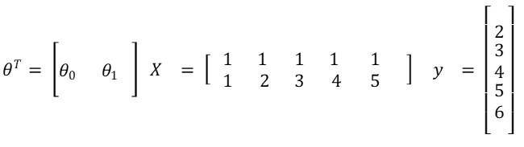
Vectorization

Slide 22
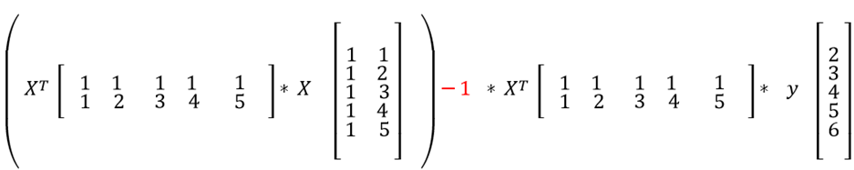
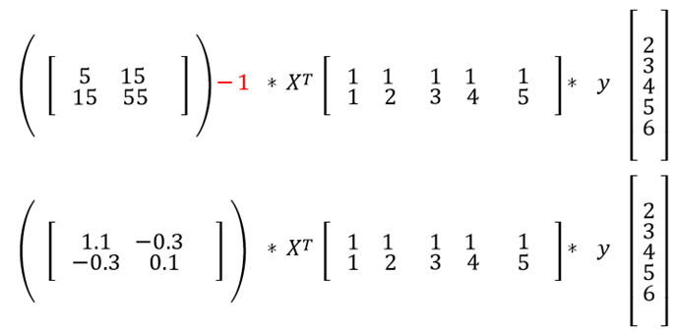
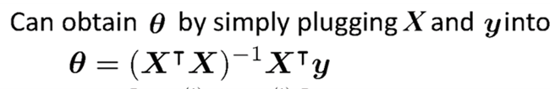
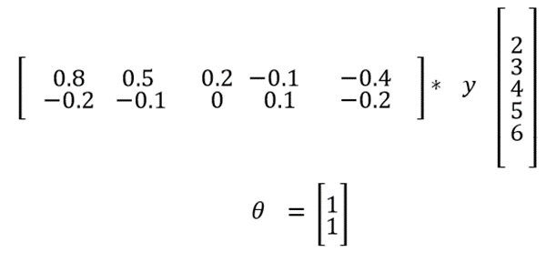
Fit the Linear Regression Model :
Using Closed Form – Problem Type 1

Slide 23
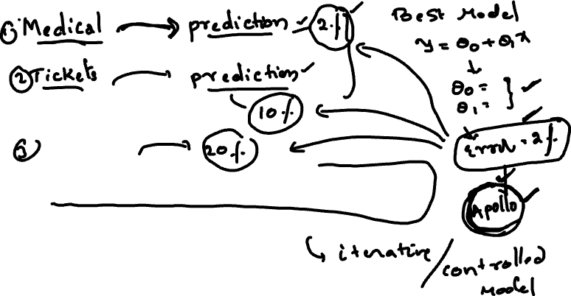
Gradient Descent Approach

Slide 24
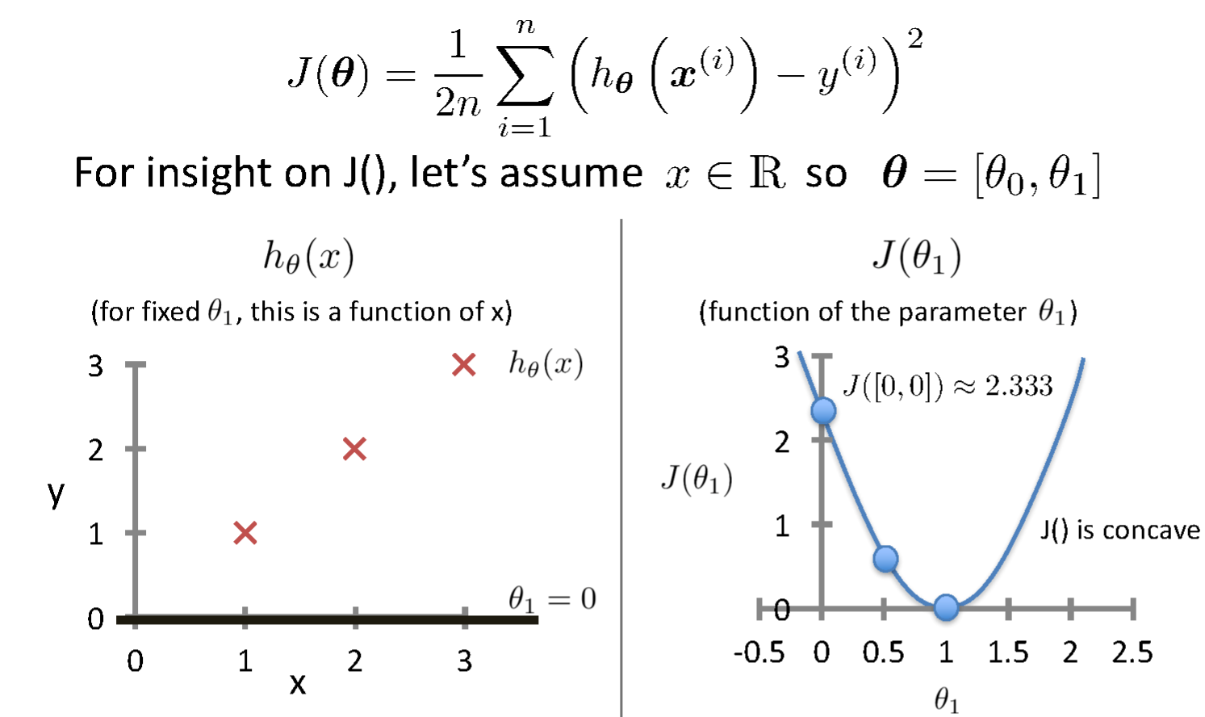
Intuition Behind Cost Function
Source Credit :

Slide 25
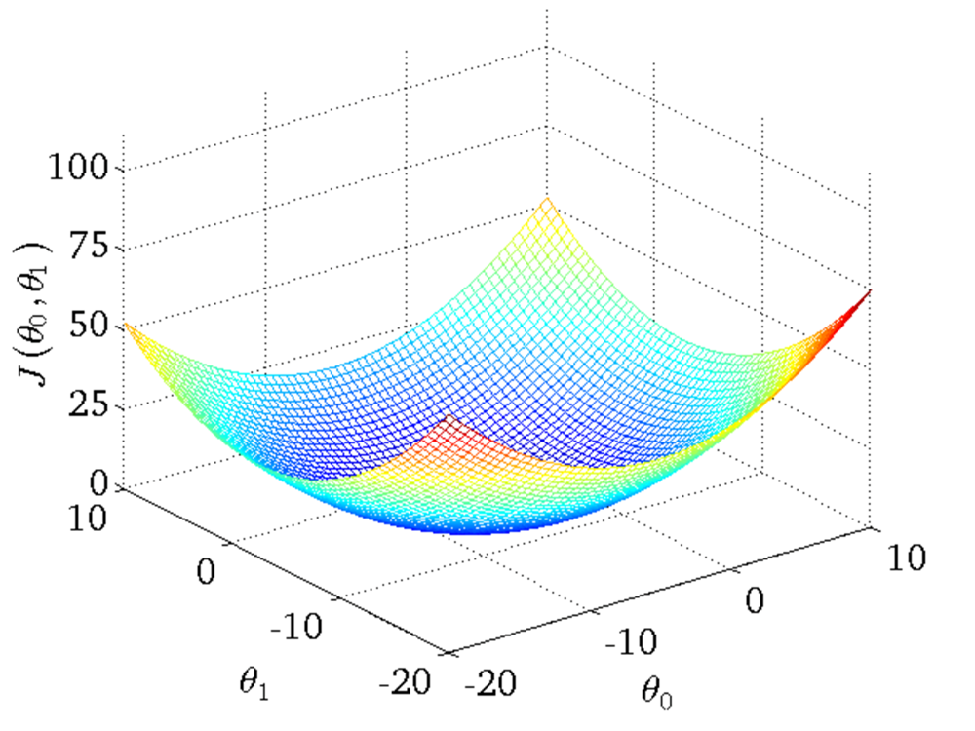
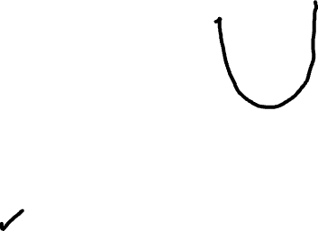
Intuition Behind Cost Function
Source Credit :

Slide 26
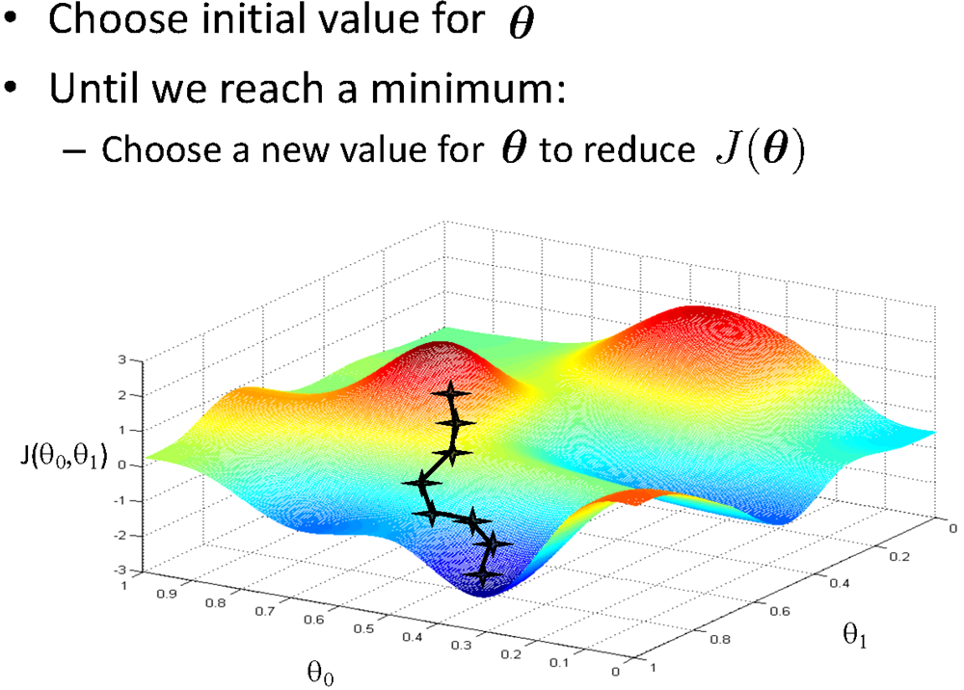
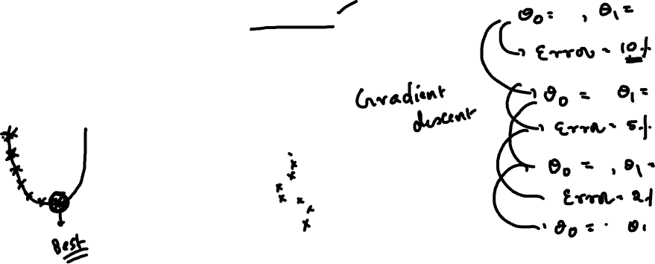
Basic Search Procedure
Source Credit : Figure by Andrew Ng

Slide 27
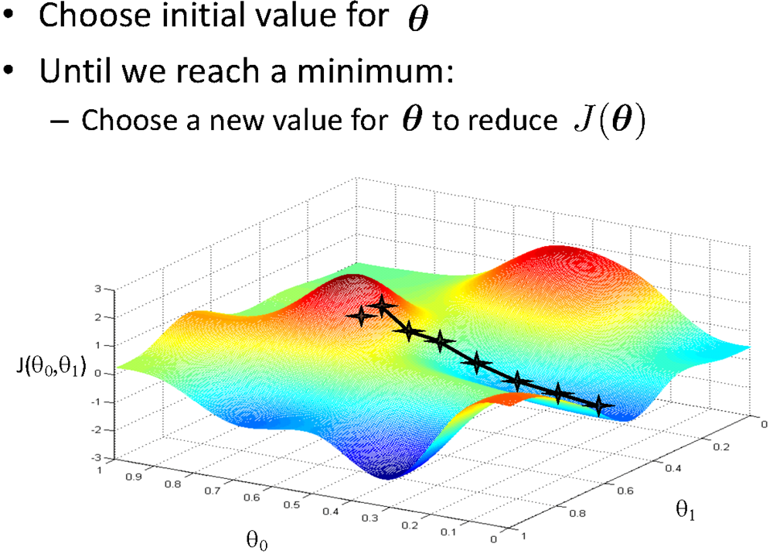
Basic Search Procedure
Source Credit : Figure by Andrew Ng

Slide 28
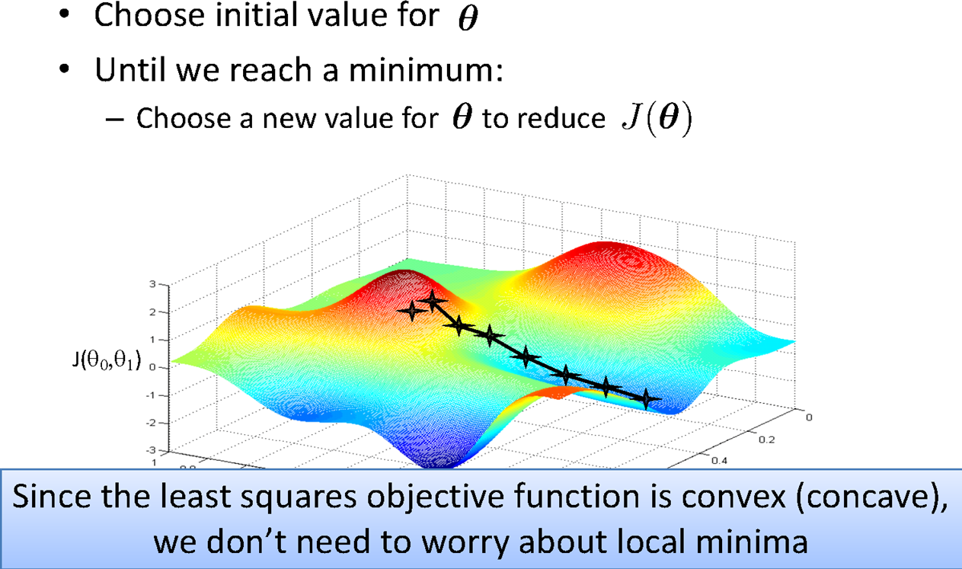
Basic Search Procedure
Source Credit : Figure by Andrew Ng

Slide 29
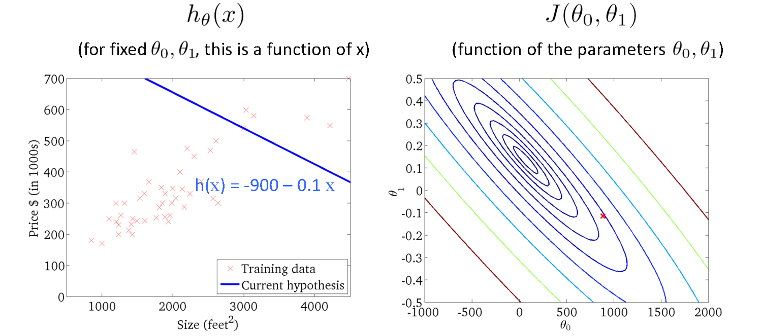
Gradient Descent
Size in feet² (x) | Price ($) in 1000's (y)
2104 | 460
1416 | 232
1534 | 315
852 | 178
… | …
Source Credit : Slide by Andrew Ng

Slide 30
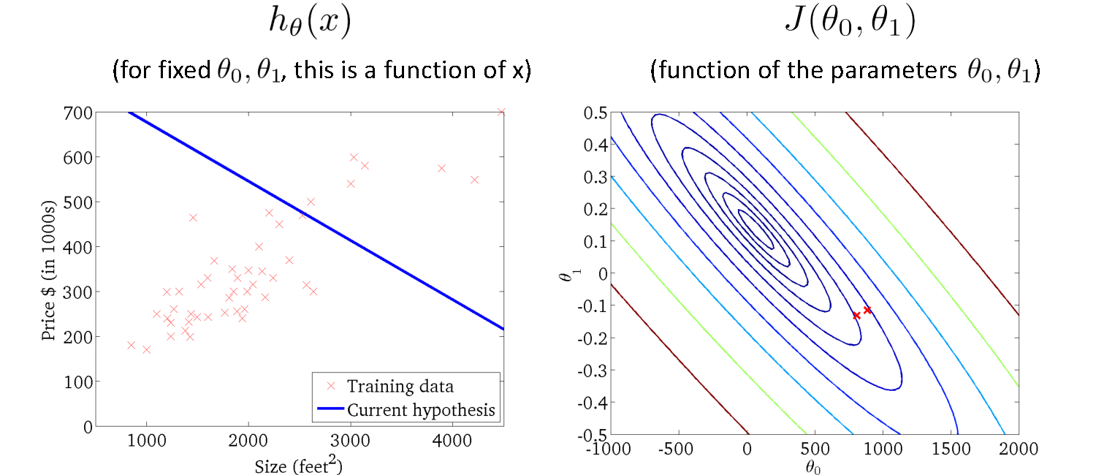
Gradient Descent
Source Credit : Slide by Andrew Ng

Slide 31
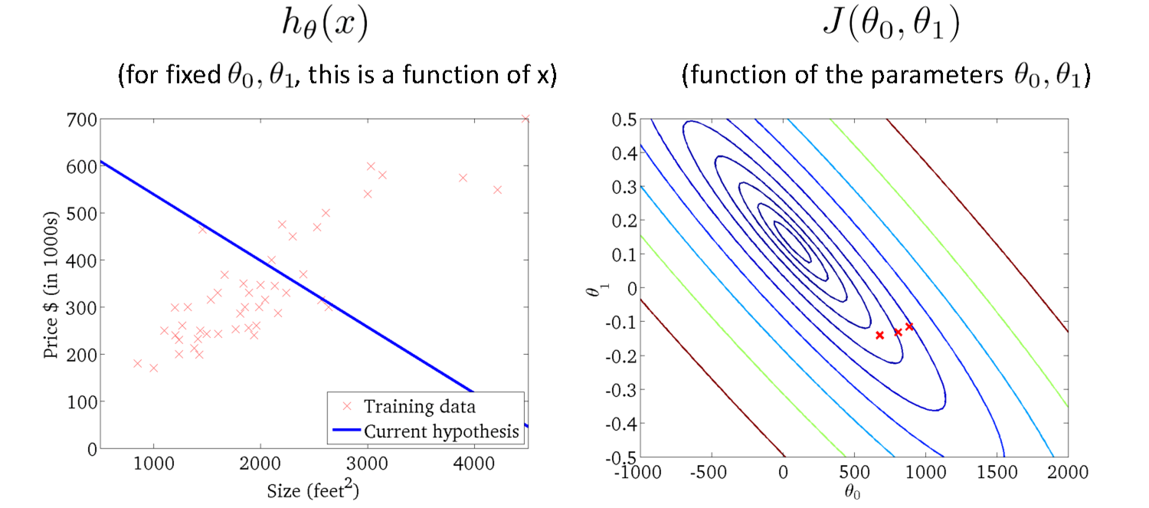
Gradient Descent
Source Credit : Slide by Andrew Ng

Slide 32
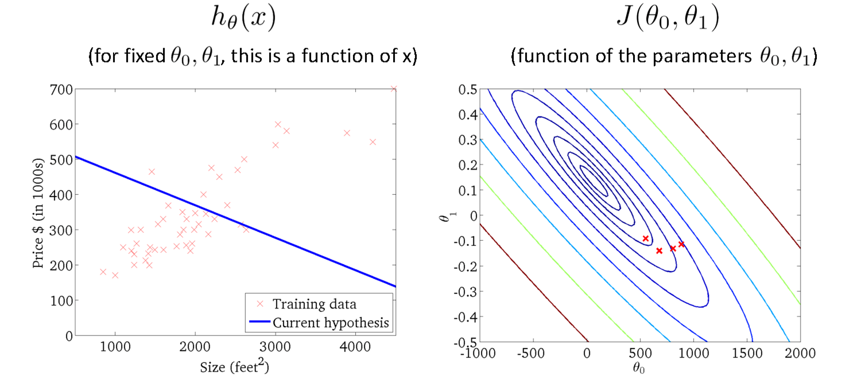
Gradient Descent
Source Credit : Slide by Andrew Ng

Slide 33
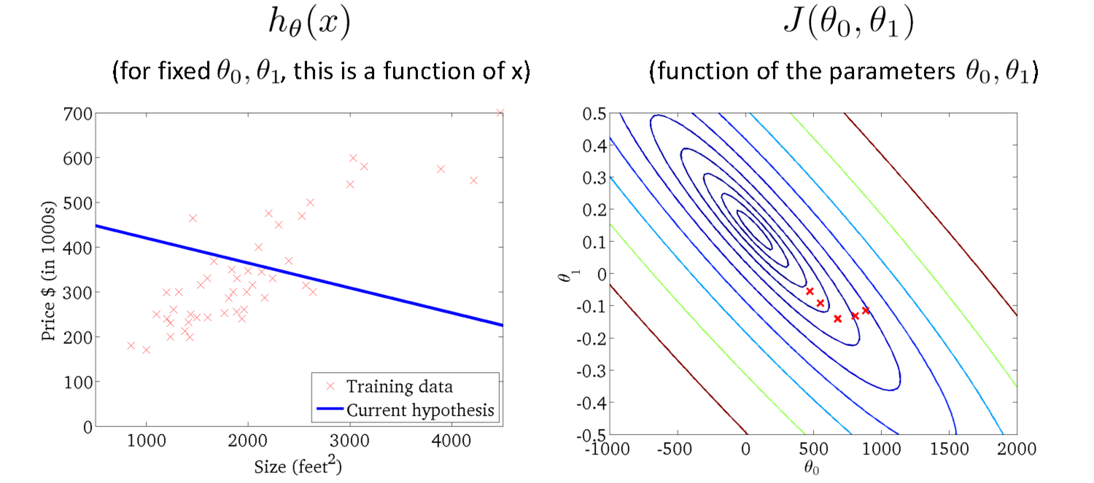
Gradient Descent
Source Credit : Slide by Andrew Ng

Slide 34

Gradient Descent
Source Credit : Slide by Andrew Ng

Slide 35

Gradient Descent
Source Credit : Slide by Andrew Ng

Slide 36

Gradient Descent
Source Credit : Slide by Andrew Ng

Slide 37

Gradient Descent
Source Credit : Slide by Andrew Ng

Slide 38


Gradient Descent

Slide 39


Gradient Descent

Slide 40


Gradient Descent for Linear Regression

Slide 41






Guarantee of Convergence
Positive Derivative
𝞱₁
𝞱₁
𝞱₁
New 𝞱₁
Old 𝞱₁
Source Credit: Prof. Mohammad Hammoud

Slide 42



Guarantee of Convergence
Negative Derivative
𝞱₁
𝞱₁
𝞱₁
Old 𝞱₁
New 𝞱₁
Source Credit: Prof. Mohammad Hammoud

Slide 43


Choosing Learning Rate

Slide 44

Gradient Descent algorithm : Effect of Learning Rate
Problem Type 2 – Interpretation of Convergence or Effect of Hyper parameters

Slide 45



Fit a linear Regression Line :
Gradient Descent : Problem Type 3
Steps :
(Assuming : ‘n’ no.of.instances and two predictors {x1, x2} and linear regression)
Identification of the equations
Cost function & derivative
$θ_{0}^{′}=θ_{0}−\frac{1}{n}$*learning rate*(sum
${ θ}_{1}^{′}=θ_{1}−\frac{1}{n}$*learning rate*(sum $(θ_{0}$+$θ_{1}x_{1}+θ_{2}x_{2}−y)∗x_{1})$
${ θ}_{2}^{′}=θ_{2}−\frac{1}{n}$*learning rate*(sum $(θ_{0}$+$θ_{1}x_{1}+θ_{2}x_{2}−y)∗x_{2})$
3. Apply the equations
$y=θ_{0}$+$θ_{1}x_{1}+θ_{2}x_{2}$
$(θ_{0}$+$θ_{1}x_{1}+θ_{2}x_{2}−y))$

Slide 46



Fit a linear Regression Line :Gradient Descent
Fit a linear regression. Show only the first iteration of Gradient descent algorithm using learning rate of 0.02 for the following data , if the Relative Risk of Coronary Heart Disease is believed to be only linearly dependent on BMI as well as Diastolic Pressure. Assume the intercept of the regression model as 5 and the slope of independent variables as -0.03 (negative).
Identification of the equations: RR-CHD = 5 – 0.03 * BMI – 0.03 * Diastolic Pressure
Cost function & derivative
$θ_{0}^{′}$ = $θ_{0}$ – 1/3 * 0.02 * (sum (5-0.03*BMI - 0.03*Diastolic Pressure - RRCHD))
= 5 – 1/3 * 0.02 * (sum (5-0.03*BMI-0.03*Diastolic Pressure - RRCHD))
${ θ}_{1}^{′}$ = $θ_{1}$ – 1/3 * 0.02 * (sum (5-0.03*BMI-0.03*Diastolic Pressure - RRCHD) * BMI)
= -0.03 – 1/3 * 0.02 * (sum (5-0.03BMI-0.03DiastolicPresure - RRCHD) * BMI)
$θ_{2}^{′}$ = $θ_{2}$ – 1/3 * 0.02 * (sum (5-0.03*BMI-0.03*Diastolic Pressure - RRCHD) * Diastolic Pressure)
= -0.03 – 1/3 * 0.02 * (sum (5-0.03BMI-0.03Diastolic Pressure - RRCHD) * Diastolic Pressure)
Apply the equations : Answer at the end of first iteration:
$θ_{0}$ = 5.0016 , $θ_{1}$ = 0.0476, $θ_{2}$= 0.179

Slide 47


Closed Form Solution Vs. Gradient Descent

Slide 48

Types of Gradient Descent Algorithms

Slide 49


Gradient Descent: Variants
Batch gradient descent refers to calculating the derivative from all training data before calculating an update.
Minibatch refers to calculating derivative of mini groups of training data before calculating an update.
Stochastic gradient descent refers to calculating the derivative from each training data instance and calculating the update immediately

Slide 50


Gradient Descent: Variants

Slide 51


Gradient Descent: Variants

Slide 52

Gradient Descent: Variants

Slide 53


Gradient Descent: Variants - Effect on Convergence

Slide 54

Evaluation Metrics

Slide 55





Evaluation of Linear Regression Model
Mileage (in kmpl) | Car Price (in cr)
9.8 | 10.48
9.12 | 1.75
9.5 | 6.95
10 | 2.51
…. | …..
Unseen Data
Mileage (in kmpl) | Car Price (in cr)
7.5 | 9.25
10 | 6.5
…. | …..
Model 1
CarPrice = 8.5 + 0.5 Mileage – 1.5 Mileage²
Model 2
CarPrice = -5.5 + 1.5 Mileage

Slide 56

Evaluation of Linear Regression Model
variation in ‘y’ that is explained by a regression model
R-squared
Mileage (in kmpl) | Car Price (in cr)
9.8 | 10.48
9.12 | 1.75
9.5 | 6.95
10 | 2.51
…. | …..
Car Price (in cr)
10.48
1.75
6.95
2.51
Mean Y
variation in ‘y’ that is not captured/explained by a regression model
Model 1
CarPrice = 8.5 + 0.5 Mileage – 1.5 Mileage²
variation that is explained by a regression model
measures the goodness of fit of a regression model
56

Slide 57

Linear Basis Models
What if output is a non-linear function of input vector?

Slide 58




Polynomial Regression
17 / 22

Slide 59





Linear Basis Function Models

Slide 60



Linear Basis Function Models
Example: an M-th order polynomial function of one dimensional feature x :
where x^{j} = j-th power of x
Φ_{j}(x) are known as basis functions. Typically, Φ₀(x) = 1, so that w₀ acts as a bias.
In the simplest case, we use linear basis functions : Φ_{d}(x) = x_{d}.
They are called linear models because this function is linear in w.

Slide 61







Linear Basis Function Models - Examples

Slide 62
Notion of Bias - Variance

Slide 63

Quality of Fit

Slide 64

Handling Overfitting – Way 1
Increase in Size of the data set reduces the over-fitting problem

Slide 65


Effect of Training Size on Over fitting
Problem Type 4 : Interpretation of the Model Fit
Size of training dataset needs to be large to prevent when higher order model is used.
Higher order model
Lower order model

Slide 66

Polynomial Fitting can lead to Overfitting
Handling Overfitting – Way 2 – Reduce the complexity of the model
Underlying target function is quadratic
Linear model results in under fitting with large bias
Polynomial of order 300 results in a large variance

Slide 67

How to experiment on Model Complexity ?

Slide 68

Handling Overfitting – Way 3

Slide 69
Regularization (*This notion is common for both Linear Regression – Module 3 and Logistic Regression – Module 4)

Slide 70

Overfitting vs Underfitting
Overfitting
Underfitting
Fitting the data too well
Features are noisy / uncorrelated to concept
Learning too little of the true concept
Features don’t capture concept
Too much bias in model

Slide 71

Regularization

Slide 72

Regularization

Slide 73

Understanding Regularization

Slide 74

Understanding Regularization

Slide 75

Understanding Regularization

Slide 76


Regularization Ridge Regression / Tikhonov regularization

Slide 77




Regularization
Lasso Regression (Least Absolute Shrinkage and Selection Operator Regression)

Slide 78



Regularization Elastic Net
+ r
Control the regularization using the Mix Ration “r”:
When,
r = 0, Elastic Net is equivalent to Ridge Regression,
r = 1, it is equivalent to Lasso Regression
from sklearn.linear_model import ElasticNet
ElasticNet(alpha=0.1, l1_ratio=0.5)

Slide 79
How to choose the right Regularization? Common Usage & Observation
L1 regularization has the ability to set some coefficients to 0 exactly leading to a sparse model
L1 regularization helps in feature selection by eliminating the features that are not important
L1 cannot be used efficiently in gradient-based approaches since it is not-differentiable unlike L2
L2 will in general lead to small magnitudes of weights but not exactly 0.
Elastic net – Prefer in Highly correlated features

Slide 80
Assumptions
Linearity
Independence of Errors
Homoscedasticity
Normality of Errors
No Multicollinearity

Slide 81
How to check assumptions?
Linearity : Scatter plots of predictors against the response variable can be used, and residual plots can help check this assumption.
Independence of Errors:Durbin-Watson test or inspecting residual plots for patterns can detect autocorrelation.
Homoscedasticity: Plotting residuals versus predicted values can help visualize if the spread of residuals is constant.
Normality of Errors:Q-Q plots or the Shapiro-Wilk test can be used
No Multicollinearity:The Variance Inflation Factor (VIF) can help detect high correlations among predictors
Faculty

Slide 82

Thank you

